Slide 1
BinarX Summer 2024 School Holiday Program
Introduction to Electronic Design
January 2024
Fergus Downey and Jacob Cook

Slide 2
Objectives
Familiarise ourselves with the fundamentals of electric circuits
Current divides around branches (water analogy)
Ohms law
Power (voltage x current)
How to wire up a basic digital chip
Power
Ground
Decoupling Capacitor (little power supply buffer - look for a good analogy)
Schematics
Breadboards
Protoboard
Measuring voltages with a multimeter
Explanation of Two Important Analog Circuits:
Resistor-divider (aka voltage divider)
Op-Amp (the swiss army knife of electrical components) amplifier

Slide 3
Ohms Law

Slide 4
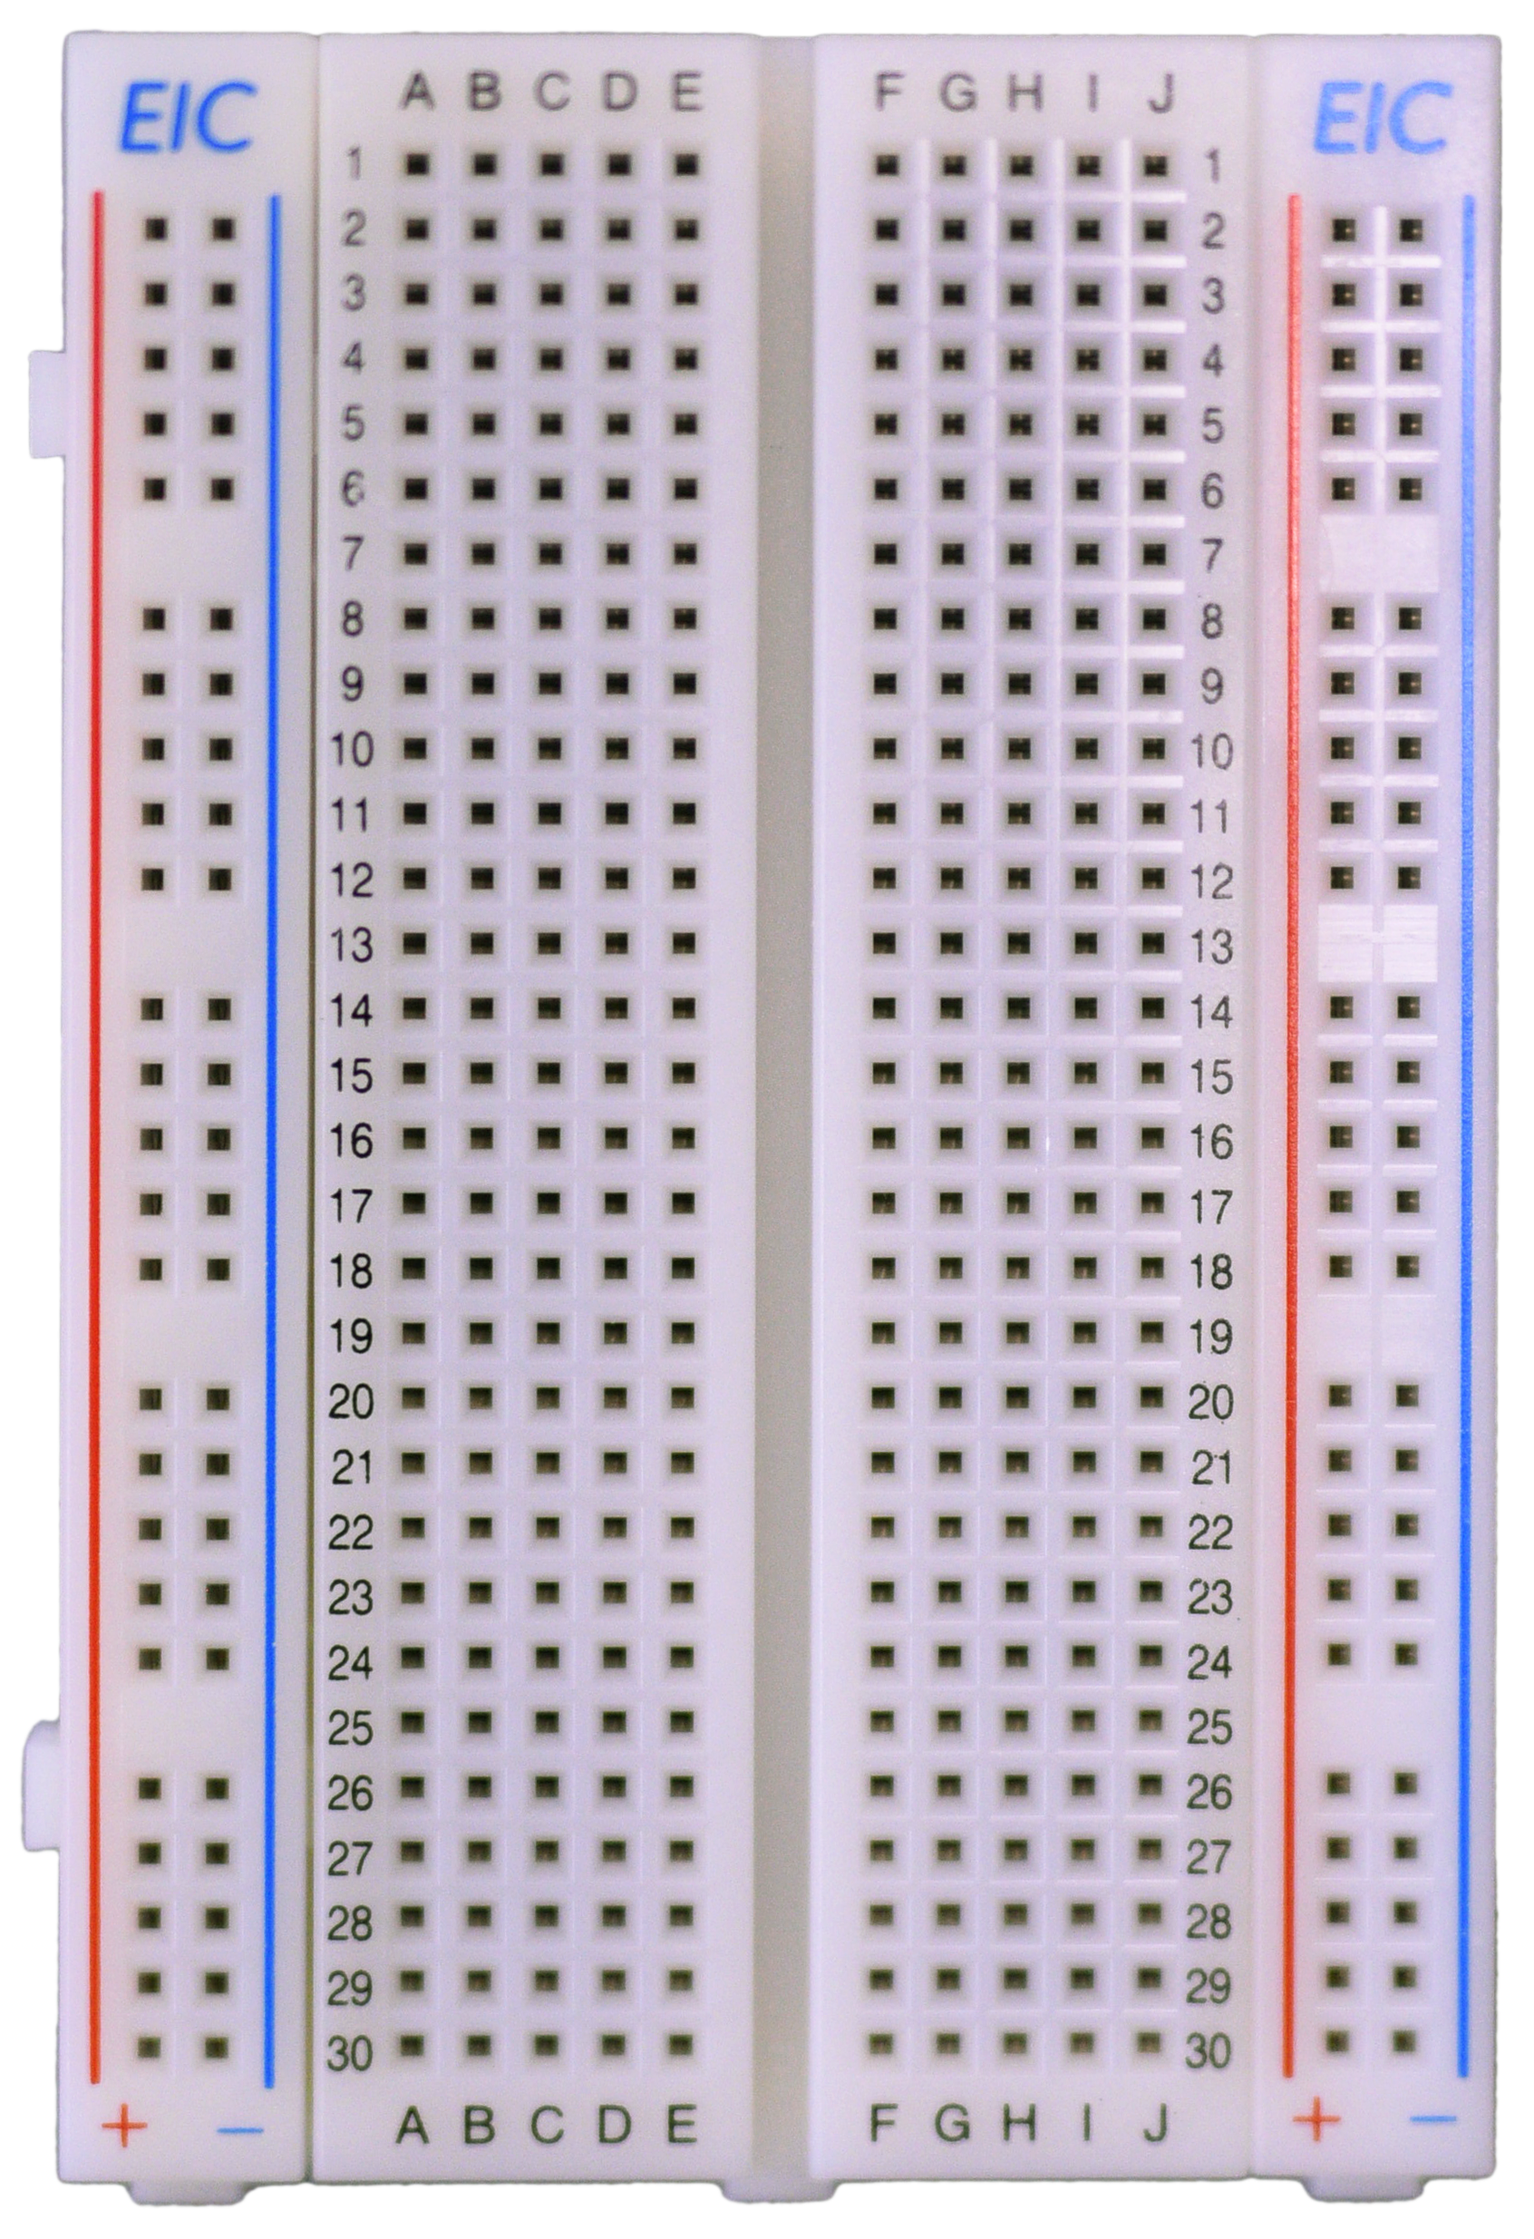

Slide 5
Questions?
Thanks for listening!

